Slide 1
READING INSTRUCTION FOR YOUNG CHILDREN IN AN ENGLISH LANGUAGE COUNTRY:
FALSE PREMISES AND POOR PERFORMANCES
Seminar presented at the
University of Languages & International Studies
Hanoi, Vietnam
March 23, 2017
James W. Chapman, PhD
Professor of Educational Psychology
Massey University
New Zealand

Slide 2
NZ has followed a predominantly constructivist approach to literacy education for the past 25 years.
Hattie (2007): “students do not learn to read by osmosis, inquiry learning, or by constructivist teaching. Instead there needs to be planned, deliberate, explicit and active programmes to teach specific skills.”
There is little or no explicit teaching of phonemic awareness and alphabetic coding skills.

Slide 3
Word analysis activities, if any, arise primarily from the child’s responses during text reading and focus mainly on initial letter sounds.
Underpinning the constructivist approach to literacy teaching is the “multiple cues” theory of reading (or “searchlights” model).

Slide 4
“…in efficient rapid word perception the reader relies mostly on the sentence and its meaning and some selected features of the forms of words. Awareness of the sentence context (and often the general context of the text as a whole) and a glance at the word enables the reader to respond instantly” (Clay, 1991, p.8).

Slide 5
Beginning readers “need to use their knowledge of how the world works; the possible meaning of the text; the sentence structure; the importance of order of ideas, or words, or of letters; the size of words or letters; special features of sound, shape and layout; and special knowledge from past literary experiences before they resort to left to right sounding out of chunks or letter clusters or, in the last resort, single letters” (Clay, 1998, p.9, emphasis added).

Slide 6
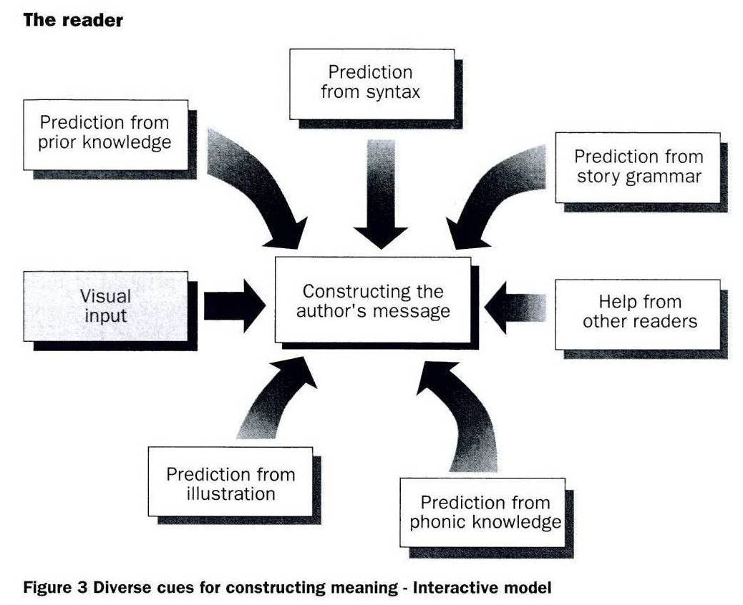
Multiple cues theory of reading

Slide 7
What do you say to a child who is reading a text when they come across a word the don’t know, get stuck on, or say the wrong word?
What do you do when you are reading and come across a word you don’t know?

Slide 8
PIRLS 2011 mean reading scores for English-speaking comparison countries
Country | Mean Scale Score | Standard Deviation
5. Northern Ireland | 558 | 76
6. United States | 556 | 73
10. Ireland | 552 | 75
11. England | 552 | 82
12. Canada | 548 | 69
23. New Zealand | 531 | 88
27. Australia | 527 | 80

Slide 9
Children who do not possess sufficient literate cultural capital (i.e., background language experiences) at school entry will (without supplemental instruction) be forced to rely increasingly on ineffective word identification strategies.

Slide 10
Mean reading achievement scores for New Zealand as a
function of ethnicity and PIRLS test cycle
 | Ethnic Group
Test Cycle | Pākehā/ European | Asian | Māori | Pasifika
PIRLS 2001 | 552 | 540 | 481 | 481
PIRLS 2006 | 552 | 550 | 483 | 479
PIRLS 2011 | 558 | 542 | 488 | 473

Slide 11
Continuum of Approaches to Beginning Reading Instruction
Isolated Skill-and-Drill Approach | Metacognitive Strategy Teaching Approach | Whole Language Approach
Atomistic view of reading acquisition; reading broken down into several subskills Heavy emphasis on teaching subskills in isolation; much seatwork and use of workbooks | Dynamic view of reading acquisition; child seen as active learner Emphasis on developing self-improving strategies for recognizing words and on how and when to use such strategies | Reading acquisition seen as natural process that is meaning driven; “no meaning, no gain” Minimal emphasis on word analysis activities; should only arise incidentally in context of reading connected text.

Slide 12
The Cognitive Foundations of Learning to Read

Slide 13
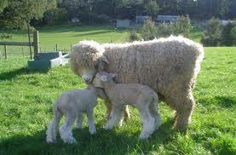
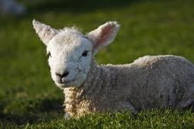
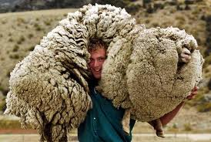
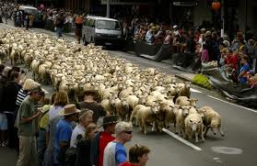

Slide 14
Cảm ơn bạn
j.chapman@massey.ac.nz

